Slide 1
Numerical analysis
MSc in Artificial Intelligence
Module assignment 1: Statistical Analysis Presentation
Tutor: Dr Russell Kabir
January 2025

Slide 2
Health Survey for England (2011): a brief introduction
The Health Survey for England (HSE) series is designed to monitor trends in the nation's health. The study provides regular information that cannot be obtained from other sources on a range of aspects concerning the public's health and many of the factors that affect health*.
The core topics of the survey are on general health and psycho-social measures (e.g. questions about feeling depressed, having mental health illness, and types of counselling or therapy for a mental health or emotional problem) *.
HSE_2011 dataset consists of 58 variables and a sample of 10 617 people
*UK Data Archive Study Number 7402 - Health Survey for England, 2011: Teaching Dataset

Slide 3
Health Survey for England (2011): Descriptive Statistics
How many people are included in the sample? 10 617 respondents
What is the percentage of people who drink alcohol?
Percentage of people drinking alcohol, HSE 2011 (excluding N/A)
YES | 78.65%
NO | 21.35%

Slide 4
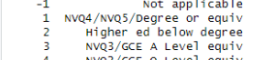
Health Survey for England (2011): Descriptive Statistics
What is the percentage of women in the sample?
4 852 Men/ 5 765 Women (55,74%)
What is the highest educational level?
NVQ4/NVQ5/Degree or equiv
NVQ Level 4 – Provides a specialist and detailed level of learning, usually covering a specific area of work. This level is ideal for those looking to manage others or work in technical roles.
NVQ Level 5 – Involves learning about an area of work on a deeper level, allowing you to understand and respond to complex situations whilst gaining a high level of expertise. Also covers senior management and the training of others.

Slide 5
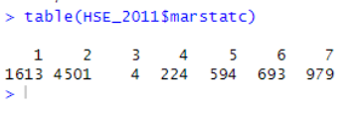
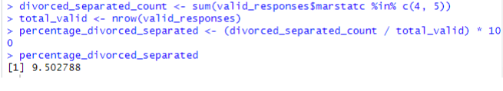
Health Survey for England (2011): Descriptive Statistics
What is percentage of divorced and separated people?
224 (4: Separated), 594 (5: Divorced), 7,7% (including N/A) or 9,5% (excluding N/A)

Slide 6
Health Survey for England (2011): Descriptive Statistics
Find the mean, median, mode, minimum, maximum, range and standard deviation of household size, BMI and age at last birthday
 | Household size | BMI | Age at last birthday
Mean | 2.85 | 25.92 | 41.56
Median | 3 | 25.59 | 42
Mode | 2 | 25.32541 | 64
Minimum | 1 | 8.34 | 0
Maximum | 10 | 65.28 | 100
Range | 9 | 56.94 | 100
Standard Deviation (SD) | 1.37 | 6.14 | 23.83

Slide 7
Health Survey for England (2011): Inferential Statistics
Run a significance test to find out which gender drinks more alcohol
The result of the Chi-square test indicates a statistically significant association between gender and drinking alcohol (p-value < 2.2e-16). This suggests that the distribution of alcohol consumption differs significantly between males and females in the dataset.
The null hypothesis (men and women have the same levels of alcohol consumption) can be rejected. There is a significant difference in alcohol consumption between males and females.
 | Drinking nowadays |  | Value of the test and p-value
Gender | Yes | No | X-squared=114.15 P-value= <2.2e-16
Male | 3172 (83.98%) | 605 (16.01%)
Female | 3540 (74.41%) | 1217 (25.58%)

Slide 8
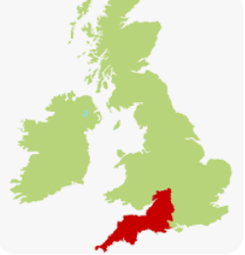
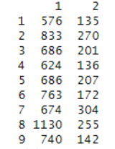
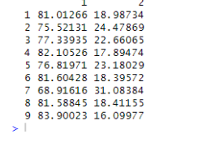
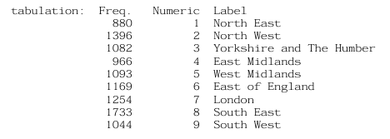
Health Survey for England (2011): Inferential Statistics
Run a significance test to find out which region drinks the most alcohol
Chi-square test was performed (X-squared=98.53)
The p-value is < 2e-16 much less than 0.05, indicating a statistically significant difference in alcohol consumption across regions as indicated by the very small p-value. The null hypothesis (all England’s regions have the same levels of alcohol consumption) can be rejected. This suggests that the England’s regions in the sample have different levels of alcohol consumption.
Region 9 (South West) stands out as a region with significantly higher alcohol consumption than several other regions (83,9%).

Slide 9
Health Survey for England (2011): Inferential Statistics
Investigate whether there is a statistical difference between men and women on the following variable:
Valid height
The data on height is not normally distributed (Anderson-Darling normality test was performed, A=398.24, P-value <2.2e-16) so the data on height significantly deviates from a normal distribution
A Wilcoxon rank-sum test (Mann-Whitney u test) was performed (W=14,713,021, P-value <2.2e-16). The extremely small p-value indicates that the difference in height between the two genders is statistically significant
The null hypothesis (men and women do not differ as for the height) can be rejected
Mean in men: The average height for men is 167.4930 cm.
Mean in women: The average height for women is 157.0564 cm
There is a statistically significant difference in height between men and women, with men being taller on average by approximately 9.64 to 11.24 cm

Slide 10
Health Survey for England (2011): Inferential Statistics
Investigate whether there is a statistical difference between men and women on the following variable:
Valid weight
The data on weight is not normally distributed (Anderson-Darling normality test was performed, A=100.8, P-value <2.2e-16) so the data on weight significantly deviates from a normal distribution
A Wilcoxon rank-sum test (Mann-Whitney u test) was performed (W=12,449,400, P-value <2.2e-16). The extremely small p-value indicates that the difference in weight between the two genders is statistically significant
The null hypothesis (men and women do not differ as for the weight) can be rejected
Mean in men: The average weight for men is 75.565 kg
Mean in women: The average weight for women is 65.720 kg
There is a statistically significant difference in weight between men and women, with men weighing more on average by approximately 8.85 to 10.84 kg

Slide 11
What is the correlation between whether a person drinks nowadays, total household income, age at last birthday and gender?
 | Drink nowadays HSE_2011$dnnow | Total household income HSE_2011$totinc | Age at last birthday HSE_2011$Age | Gender HSE_2011$Sex
Drink nowadays HSE_2011$dnnow | X | r=0.07325339 P-value=2.644e-11 | r=0.06889968 P-value=1.871e-10 | r=0.115942 P-value=2.2e-16
Total household income HSE_2011$totinc | r=0.07325339 P-value=2.644-11 | X | r=0.04988733 P-value=4.062e-07 | r=0.004751272 P-value=0.6297
Age at last birthday HSE_2011$Age | r=0.06889968 P-value=1.871e-10 | r=0.04988733 P-value=4.062e-07 | X | r=0.03268654 P-value=0.0007558
Gender HSE_2011$Sex | r=0.115942 P-value=2.2e-16 | r=0.004751272 P-value=0.6297 | r=0.03268654 P-value=0.0007558 | X

Slide 12
Health Survey for England (2011): Inferential Statistics
The value of r indicates the strength and direction of the relationship between two variables.
The p-value is used to test the null hypothesis that there is no correlation between the two variables (r=0). A very small p-value (<0.05) indicates that the correlation is statistically significant.
The majority of the relationships seem to be statistically significant but extremely weak, meaning that while there are associations between these factors and drinking behavior/total household income/age/gender, other variables may play a more significant role.

Slide 13

Discussion of the findings with reference to relevant literature on gender and alcohol in the UK
At present, 83.98% of men drink alcohol compared to 74.41% of women who claim to do so.
Gender gap in alcohol consumption is narrowing over the last years. In the past, men were considered to drink much more alcohol (units per week) and much more often (more than once per week).
Targeted advertising for a female public, pricing and changing socio-economic patterns of women might have impacted the rise in alcohol consumption among them.
Men prefer drinking beers and spirits in public spaces (pubs, bars), while women prefer drinking wine in non-public spaces (home).
Men are more likely to engage in binge drinking than women.

Slide 14
Discussion of the findings with reference to relevant literature on gender and alcohol in the UK
Women tend to suffer more alcohol-related health issues due to their body composition (fat and water content) than men.
Research has shown that lower socioeconomic status is often associated with higher rates of alcohol consumption, particularly among men.
Regional differences in drinking patterns are also evident, with people from more urban areas generally drinking more than those from rural areas.

Slide 15
Conclusions and recommendations
Targeted campaigns of awareness-raising for health risks associated with high alcohol consumption.
Pricing does have a direct impact on alcohol consumption.
Information campaigns making use of widely known role models disassociating alcohol consumption with influential and privileged social status.
A similar campaign to that on anti-tobacco can be very effective (product labelling and health warning requirements, advertisement prohibition). The share of smokers among men and women tend to continuously diminish at least in wealthier countries.
Extensive communication from doctors and health experts on the health risks associated with alcohol consumption (including physical/verbal violence, irresponsible driving, accidents etc).
Targeted campaigns for diverse social interaction environments (schools, universities, work, family).
Social media, TV, podcasts, radio, newspapers.

Slide 16
Bibliography
Institute of Alcohol Studies Available from https://www.ias.org.uk/report/women-and-alcohol/ [Accessed on 6 January 2025)
Meier PS, Holmes J, Brennan A, Angus C. (2021) Alcohol policy and gender: a modelling study estimating gender-specific effects of alcohol pricing policies. Addiction. 2021 Sep;116(9):2372-2384. National Library of Medicine, National Centre for Biotechnology Information doi: 10.1111/add.15464. Epub 2021 Mar 9 [Accessed on 3 January 2025]
NHS (2021) Health Survey 2021, Available from https://digital.nhs.uk/data-and-information/publications/statistical/health-survey-for-england/2021/part-3-drinking-alcohol [Accessed on 10 January 2025]
UK Data Service, Quick start guide: Health Survey for England (HSE), Available from https://ukdataservice.ac.uk/learning-hub/students/resources/quick-start-hse/ [Accessed on 5 January 2025]
UK Data Service (2013), UK Data Archive Study Number 7402 - Health Survey for England, 2011: Teaching Dataset Available from https://doc.ukdataservice.ac.uk/doc/7402/mrdoc/pdf/7402hse_2011_teaching_dataset_user_guide.pdf [Accessed on 7 January 2025]

Slide 17
Appendix (R Studio commands) Screenshots

Slide 18
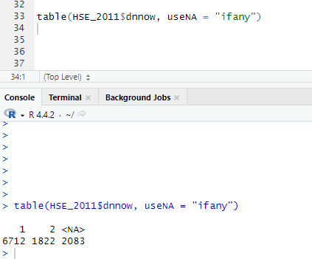
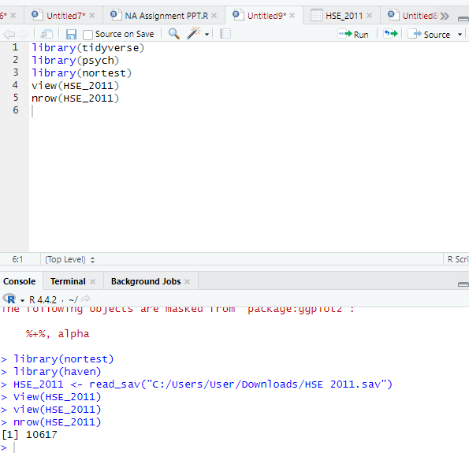
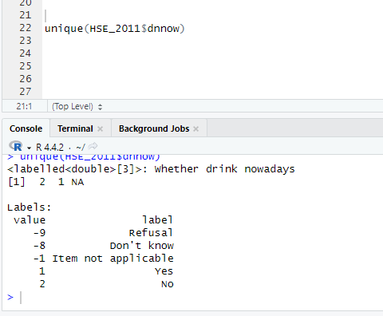

Slide 19
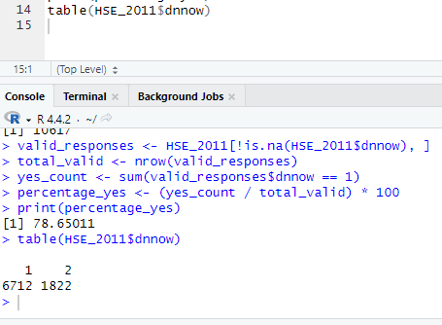
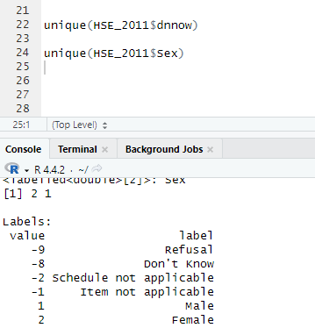
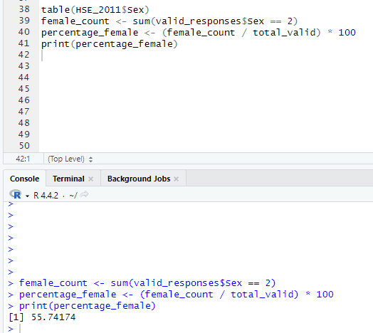
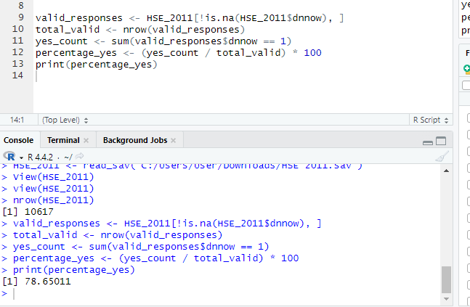
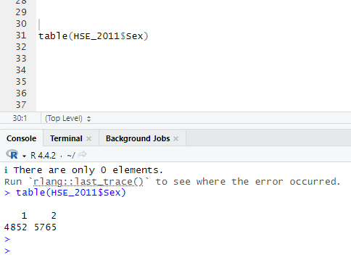

Slide 20
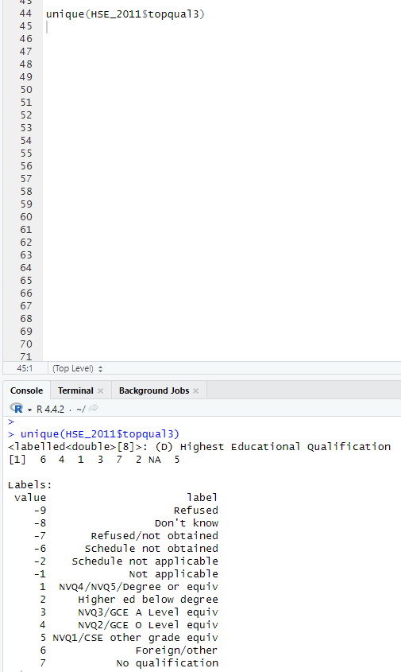
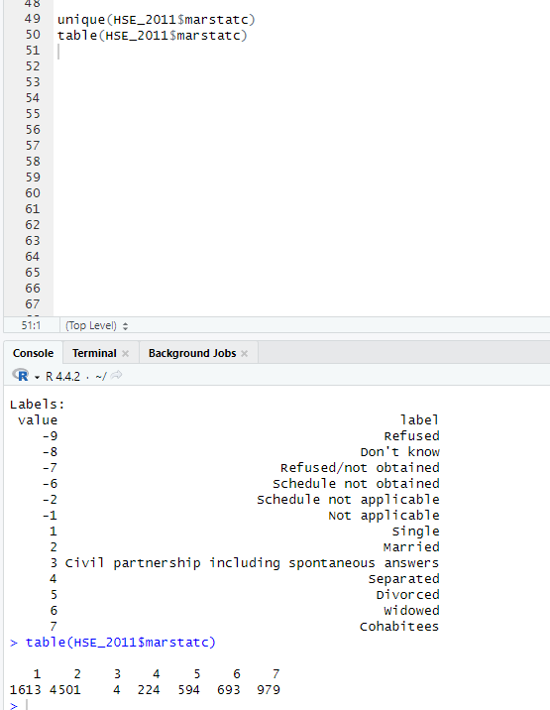
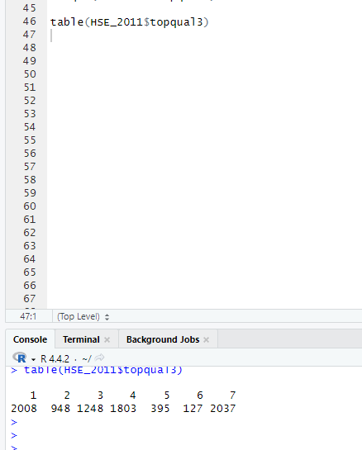

Slide 21
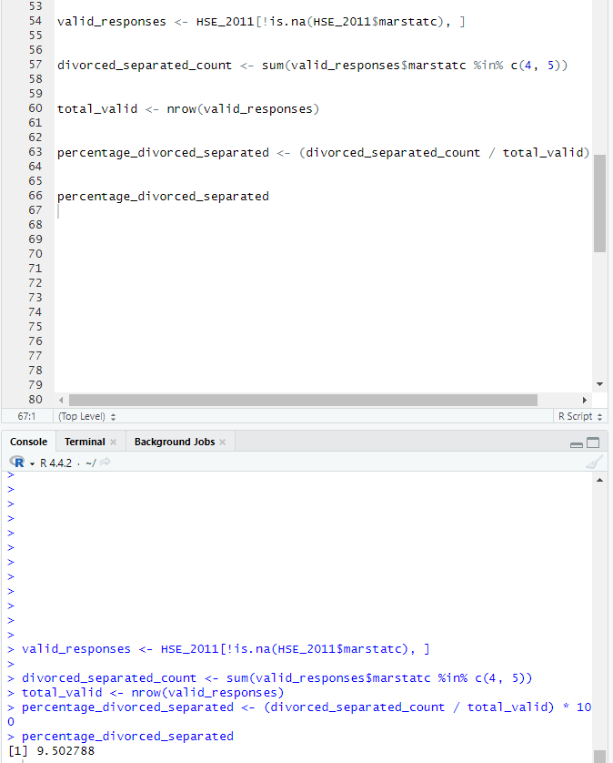
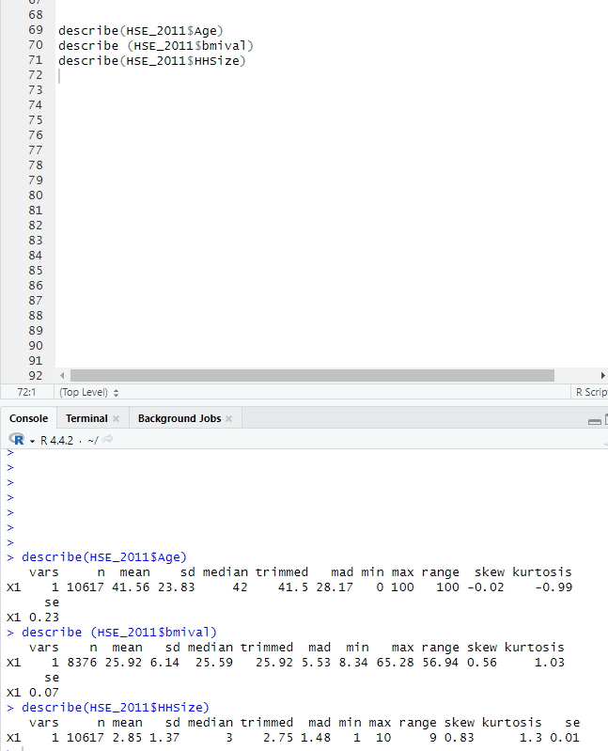

Slide 22
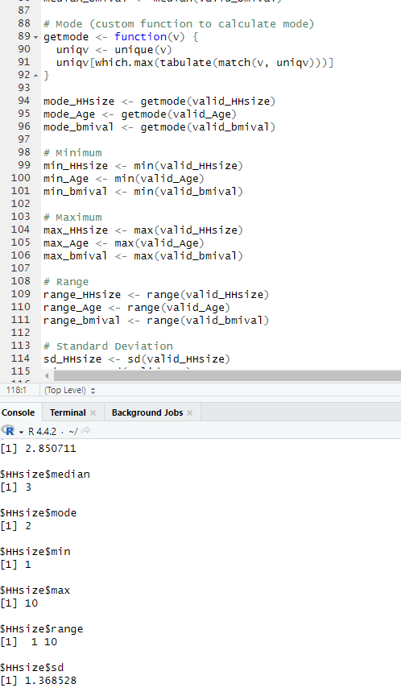
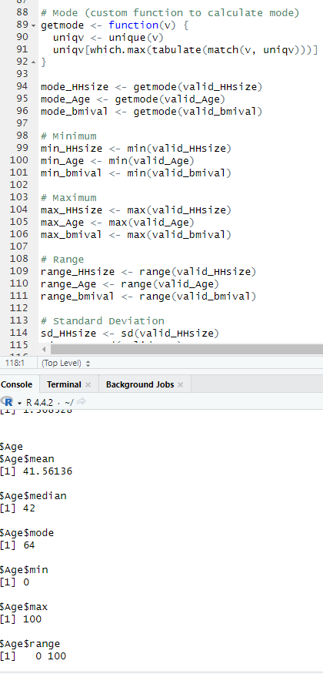
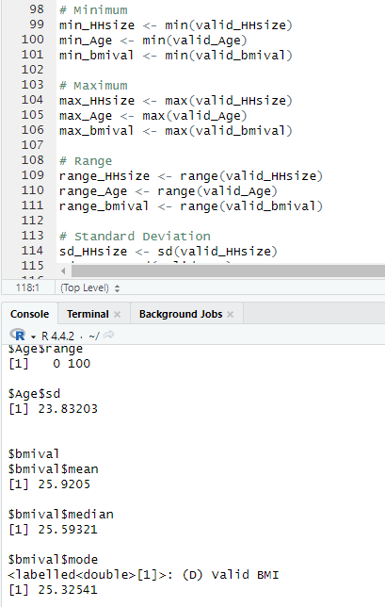

Slide 23
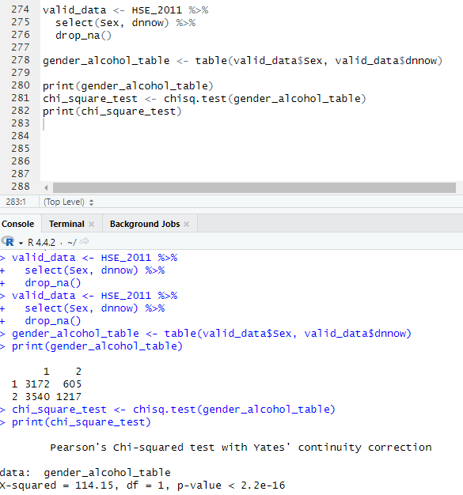
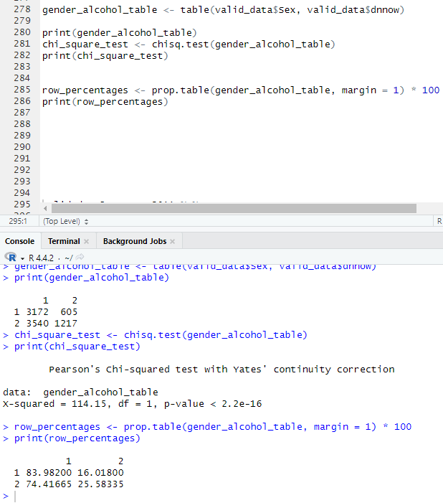

Slide 24
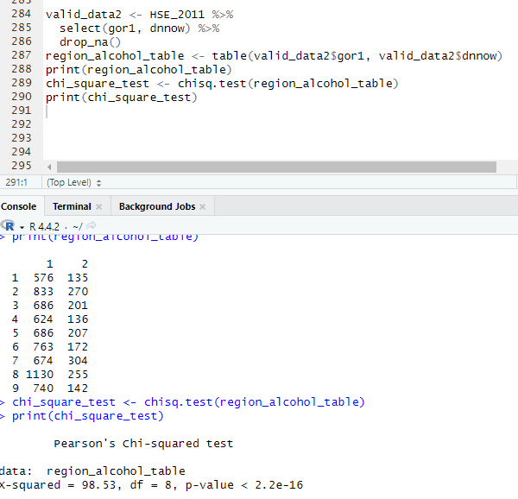
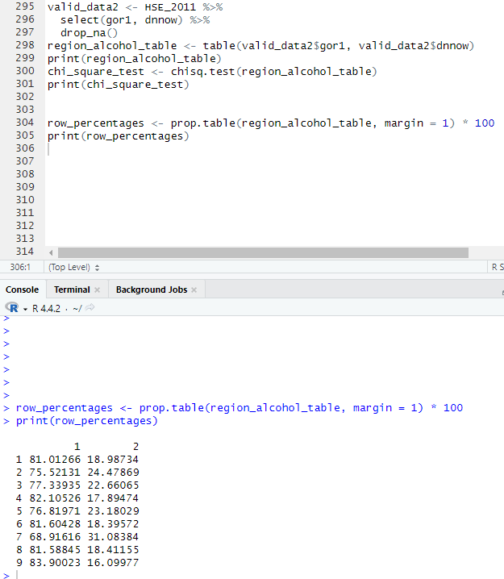

Slide 25
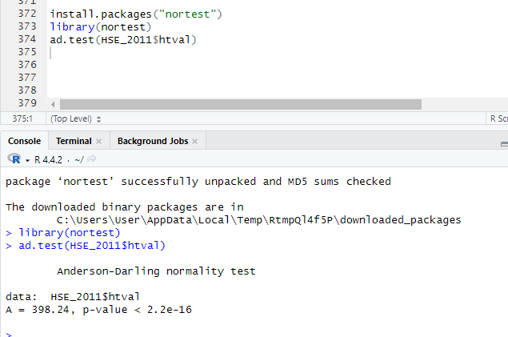
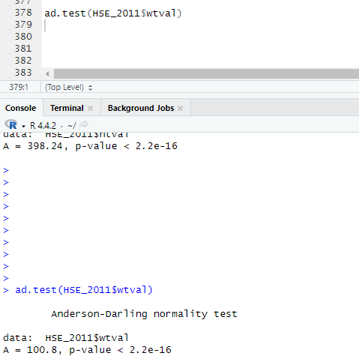

Slide 26
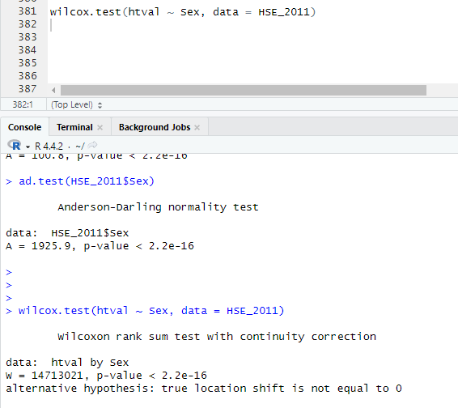
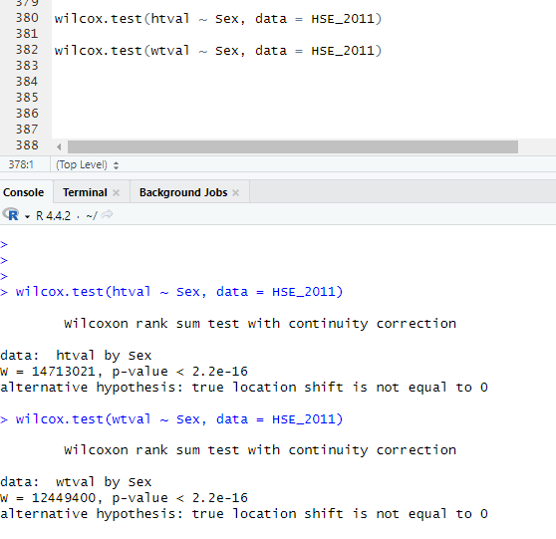

Slide 27
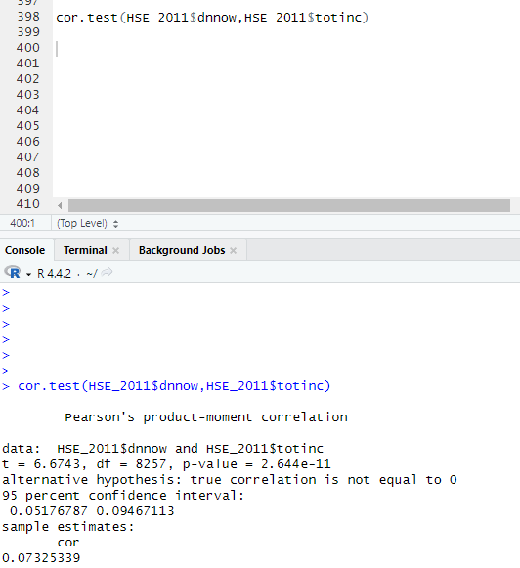
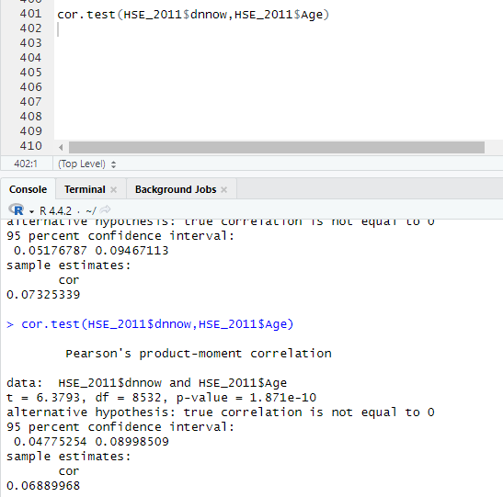
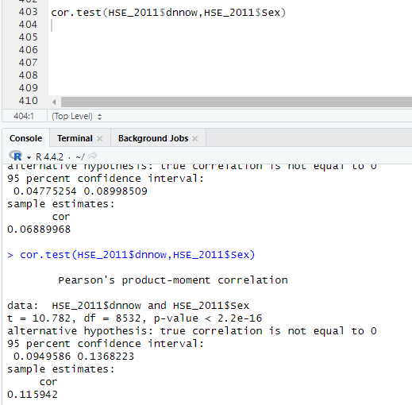

Slide 28
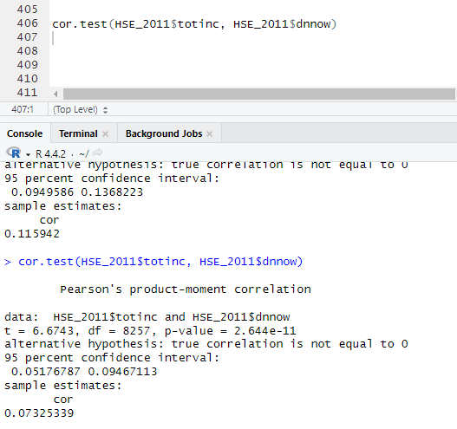
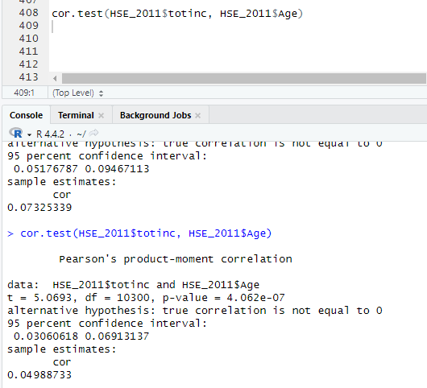
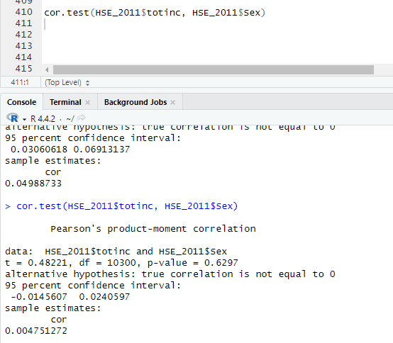

Slide 29
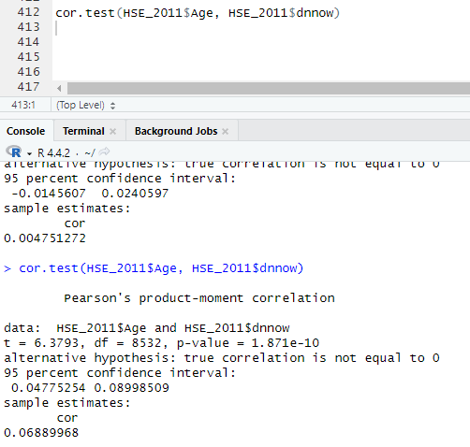
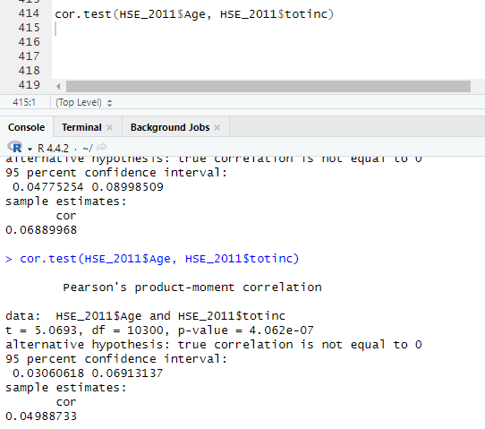
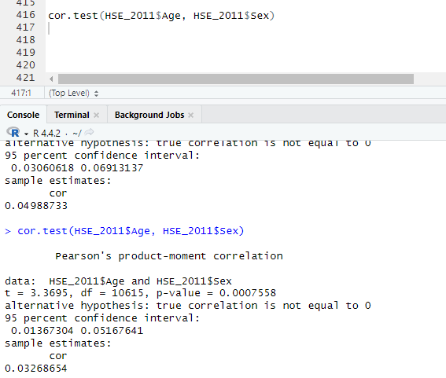

Slide 30
